Slide 1


Faculty of Computing and Informatics
Week 4
The Database Development Process

Slide 2
Recap
In the previous lecture, we discussed
Client server architecture
Types of database systems
Database system concepts

Slide 3
Objectives
By the end of this lesson, students should be able to
Describe the database development process
Identify activities at each phase of the process
Understand how the process is applied in real life projects
Describe the activities conducted at the conceptual database design phase

Slide 4
Database Development Life Cycle
Feasibility and requirements gathering phase
Design phase
Implementation phase
Maintenance
Data and Application phase
Testing Phase

Slide 5
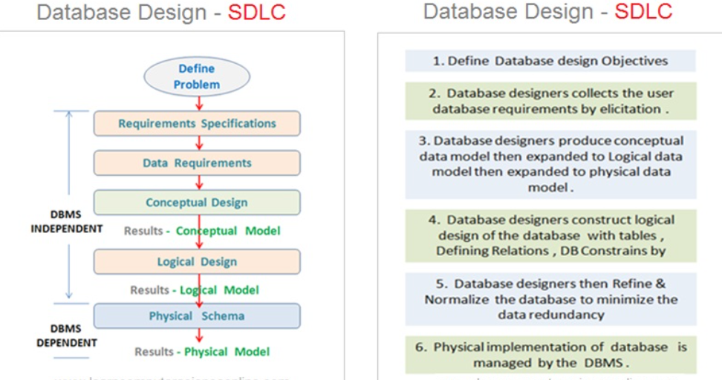
The Database Development Process

Slide 6
Feasibility and requirements gathering phase
    Examine the business case scenario within the organisation to determine
    the needs of the organisation and how the needs can be resolved through the development of a database application.

Slide 7
Requirements specification
Discover DATA and OPERATIONS requirements
Interaction with the customer
We will discuss DATA now, OPERATIONS later
Questions – what data must be available? –
How are data elements to be related?
RESULT: DATABASE REQUIREMENTS

Slide 8
Design Phase
  The relevant design to meet the needs of the organisation is carefully selected based on the findings from the feasibility and requirements gathering phase
    Database design includes the following:
      1. Conceptual database design
      2. Logical database design
      3. Physical database design

Slide 9
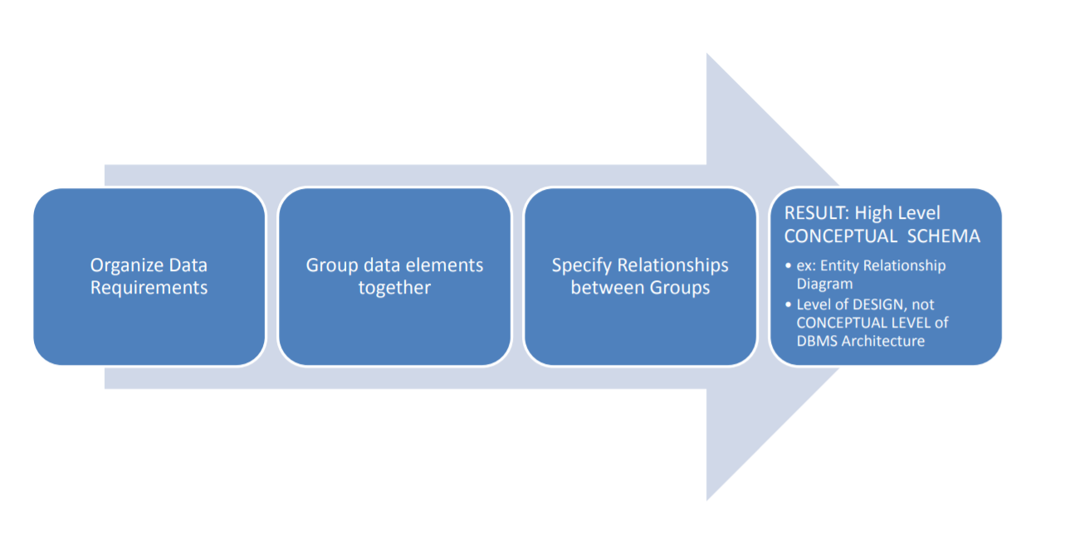
Conceptual Design
Identify the entities (Weak entities and Strong entities), determine the relationships, Entity Relationship Diagram(ERD) connecting the entities and their relationships
ERD
Crow’s foot
Chen’s notation
We will learn the ERD in the next lecture

Slide 10
Logical Design
Identify the attributes, cardinalities, determine the primary keys, foreign keys or composite keys
Implement High Level CONCEPTUAL SCHEMA in some Database
Use DATA MODEL of that DB: Relational, Network, OO…
RESULT: Database CONCEPTUAL SCHEMA –
In RDB, Table Schemas and Constraint

Slide 11
Physical Design
Identify the data types for each attribute and how you want data stored in the database
Incorporates knowledge of how the data will be used: – from the operations analysis
RESULT: INTERNAL SCHEMA
Layout – Clustering (what tables near other tables for faster disk access)
Access methods: B‐Tree, Hash Table, Indexes

Slide 12
Database Implementation Phase
  This is the process of selecting the appropriate database management system to create a working database
  The is the actual implementation of the database and converting the physical design in a functional database application
  Our Data Definition Language using SQL comes in handy here:

Slide 13
Data and Application Phase
  This is the process of storing data in the database and connecting the database to an application.
Testing Phase
  This is the process of testing the application to check whether it meets the requirements and produces the right results.
Maintenance Phase
  This is the process of testing the application to check whether it meets the requirements and produces the right results.

Slide 14
Conceptual database design
The questions to ask:
What are the entities (= objects, individuals) in the organization?
Which relationships exist among the entities?
What information (= attributes) do we want to store about these entities and relationships?
What are the business rules of the organization?
Which integrity constraints do arise from them?
The answers are represented in an Entity Relationship Diagram (ER diagram)

Slide 15
Entity
Entity: An object distinguishable from other objects (e.g., an employee)
An entity is described by a set of attributes.
Examples of entities?
Examples of things that are not entities?
Entity Set/Entity Type: A collection of similar entities (e.g., all employees)
All entities in an entity set have the same set of attributes.
Each attribute has a domain.
Each entity set has a key/ identifier

Slide 16
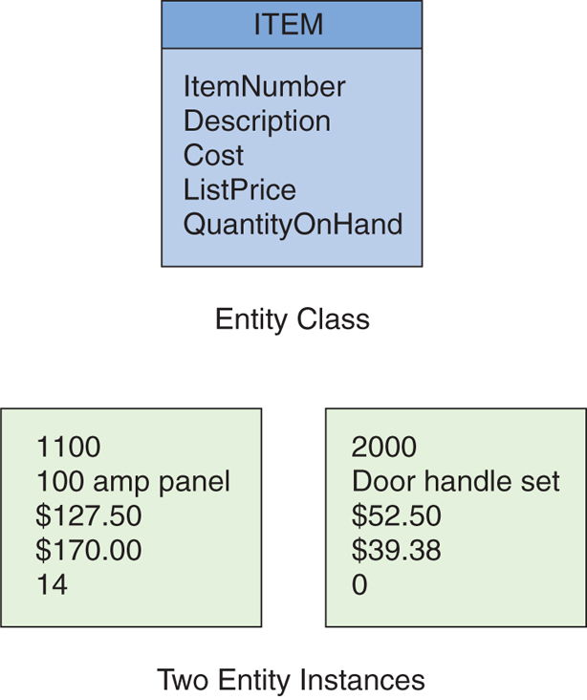
Entity Class and Entity Instance
Kroenke & Auer (2013)

Slide 17
Strong and Weak Entities
Strong entities
  -exist independently of other types of entities
  -has its own unique identifier
  -represented with single-line rectangle
Weak entity
  -dependent on a strong entity…cannot exist on its own
  -Does not have a unique identifier
  -represented with double-line rectangle

Slide 18
Entities – What should it be?
SHOULD BE:
  An object that will have many instances in the database
  An object that will be composed of multiple attributes
  An object that we are trying to model
SHOULD NOT BE:
  A user of the database system
  An output of the database system (e.g. a report)

Slide 19
Attributes
Entities have attributes that describe the entity’s characteristics:
  StudentName
  DateOfBirth
  Tribe
  Gender
  StudentNum
Attributes have a data type and properties.

Slide 20
Attributes
An attribute is a property or characteristic of an entity type that is
of interest to the organization.
Example:
Entity Type | Attributes
STUDENT | ID, First_name, Last_Name, Physical_Address, Phone_Number
CAR | Registration_Number, Colour, Horsepower
EMPLOYEE | Name, ID, Skill

Slide 21
Attributes
Single valued | can take only one value for an entity instance
Multi-valued | can take many instances
Derived | is an attribute whose values can be calculated from other attribute values.
Composite | Some attributes can be broken down into meaningful component parts. The most common example is address, which can be usually broken down into the following components: Street, City, State etc..

Slide 22
Entities - Identifiers
An identifier or key is a combination of attributes that uniquely identifies individual instances of an entity type. In an E-R diagram, the respective attribute names are underlined.
A composite identifier is an identifier that consists of a composite attribute (versus Simple Identifier).
A Candidate key is an attribute that could be a key… satisfies the requirements for being a key (all attributes depend upon this key)

Slide 23
Entities – Characteristics of Identifiers
Will not change in value
Will not be null
No intelligent identifiers (e.g. containing locations or people that might change)
Substitute new, simple keys for long, composite keys

Slide 24
Relationships
Entities can be associated with one another in relationships.
Relationship degree defines the number of entity classes participating in the relationship:
  Degree 2 is a binary relationship.
  Degree 3 is a ternary relationship.

Slide 25
Relationships -Degree of Relationship
The degree of a relationship is the number of entity types that participation in the relationship
Thus, in the previous example, the relationship Completes is of degree 2
The 3 most common relationships in E-R models are:
  Unary (degree 1) (also called recursive relationship)
  Binary (degree 2)
  Ternary (degree 3)
Higher degree relationships are possible, but rarely occur

Slide 26
Attributes on Relationships
Attributes may be associated with relationships, as well as with entities.
These describe features pertaining to the association between the entities in the relationship
Example:
Date_Completed
EMPLOYEE
Completes
COURSE

Slide 27
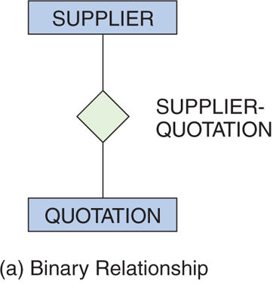
Degree 2 Relationship:
Binary
Kroenke & Auer (2013)

Slide 28
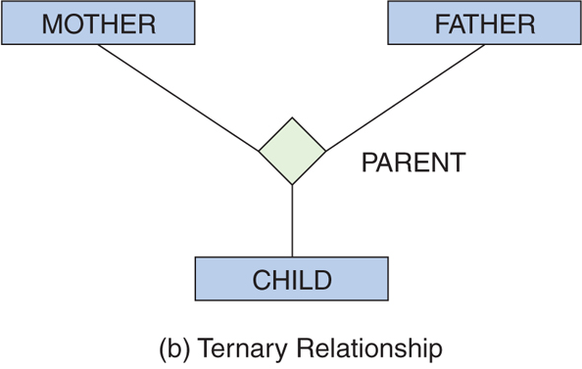
Degree 3 Relationship:
Ternary
Kroenke & Auer (2013

Slide 29
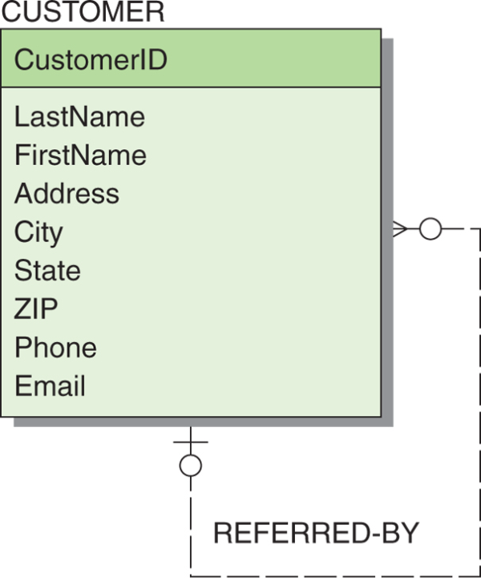
Recursive Relationships
It is possible for an entity to have a relationship to itself—this is called a recursive relationship.
Example Recursive Relationship
Kroenke & Auer (2013)

Slide 30

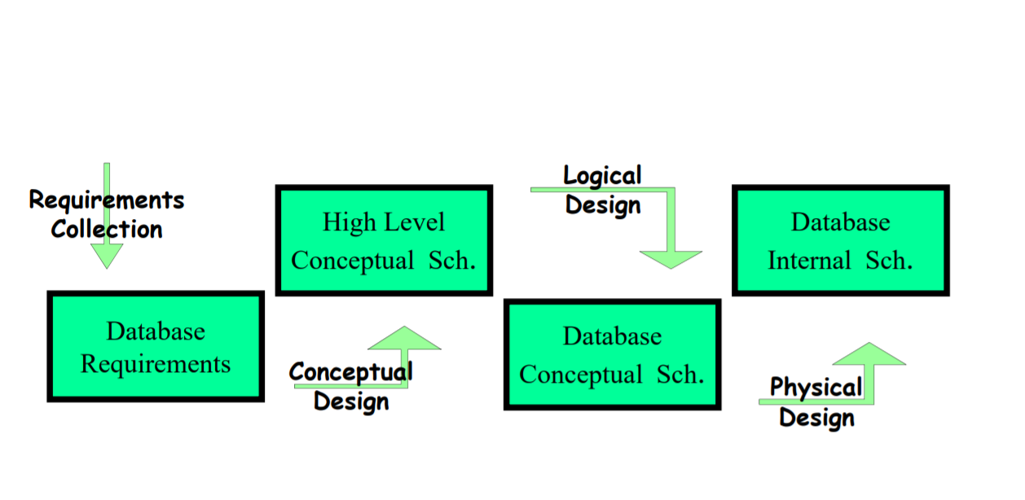
Summary
The diagram summarises the phases in the Database development process.
Take note of the activities involved at each of the phases.

Slide 31
References
Kroenke, D. M. & Auer, D. (2020). Database concepts (9th ed.), Pearson

Slide 32
Take home
Review lecture on the database concepts .
Ensure you complete the study on data types
Attend practical classes
Work on the lab 3

Slide 33
Next lecture
In the next lecture we will learn about the conceptual model.
The Entity Relationship Diagram (Crow’s foot, Chen’s notation)
Introduce the logical design stage.

